Slide 1

OUR 78th SESSION
JUNE 17 – JUNE 23, 2018
MICHIGAN STATE UNIVERSITY – SHAW HALL

Slide 2


The First Step
Once you have been selected to attend American Legion Auxiliary Girls State, you will receive a DELEGATE LETTER with instructions for registering online directly with MSU at a cost to you of $25. You will also receive a CHECKLIST that contains a snapshot of the information you will need to review and direct you to our Department website where you will find all the forms you need to complete prior to coming to ALA Girls State.
  Don’t give up if you are an Alternate! You will receive a letter with instructions to complete a form that needs to be mailed back to Beryl Robbins, Chairman for Michigan’s ALA Girls State, along with a copy of your Delegate Application. Your name and contact information will be entered into a database. We have organizations looking for girls to sponsor; and if a Delegate cancels we need to fill that spot.. We will do everything we can to make sure you have the opportunity to attend! So don’t make alternative plans for the summer that will prevent you from attending ALA Girls State! The First 20 received by Beryl were able to pre-register with MSU, and will be attending ALA Girls State!
  It is very important that you review all the forms and information on the website. Information is available for Required Forms, Scholarship Opportunities, College Credits, Membership Opportunities;; Things to Learn, and important information for your parents. If you do not have a computer please seek assistance from your school counselor, a friend or family member, or visit your local library.

Slide 3


DO YOU KNOW WHO YOUR SPONSOR IS?
The Delegate letter you receive also reflects the name and contact information for your sponsor. Please keep this information, Do not turn this letter in to your counselor when you arrive at ALA Girls State.
You will need that information during the MSU registration process. The Reservation number is very important, and you cannot register with MSU without it!
You will also be asked to report back to them after your ALA Girls State Experience!
Sponsors continue to support our program when their delegates
come back to thank them for the opportunity to attend ALA Girls State!
Help us keep the program successful!

Slide 4
What is ALA Girls State?
It’s a government simulation/leadership program held each summer in every one of the United States.
We provide “hands on” training by actually creating a mythical state…ALA GIRLS STATE…where you will learn the management of a democratic government at the city, county and state levels.
When you arrive at ALA Girls State you are assigned to a political party; either a Federalist or a Nationalist.
You will live in one of ALA Girls State’s twelve cities located in one of four counties.
You will participate in learning about your community, you might become a member of the Bar Association; maybe run for an office, be a city reporter, or sing in the ALA Girls State Choir.
There is something at ALA Girls State for everyone! Get involved!

Slide 5
Who started ALA Girls State?
The American Legion Auxiliary
Is the largest women’s patriotic organization that was formed in 1920 whose members are mothers, grandmothers, sisters, daughters and granddaughters of military veterans.
It’s a remarkable organization with dedicated women devoted to America’s veterans, young people and communities.
We are the founding and sponsoring organization of the American Legion Auxiliary Girls State program!
Michigan’s ALA Girls State was established in 1940-1941 under the direction of National President Dorothy Pearl from Detroit, and Department President Edna Alber from Ann Arbor. Our oldest County at ALA Girls State is “Alber-Pearl” County, named in their honor. All of our Counties and Cities are named in honor of our Past Department of Michigan Presidents.

Slide 6
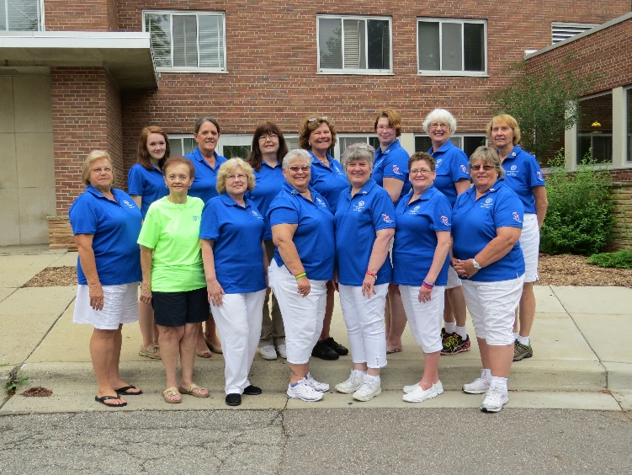
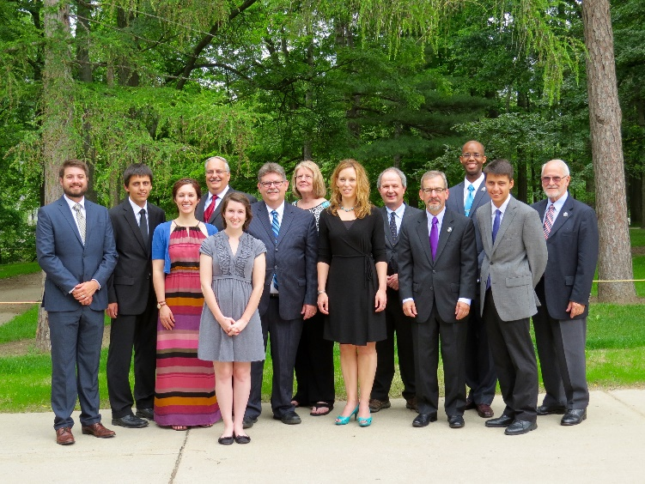
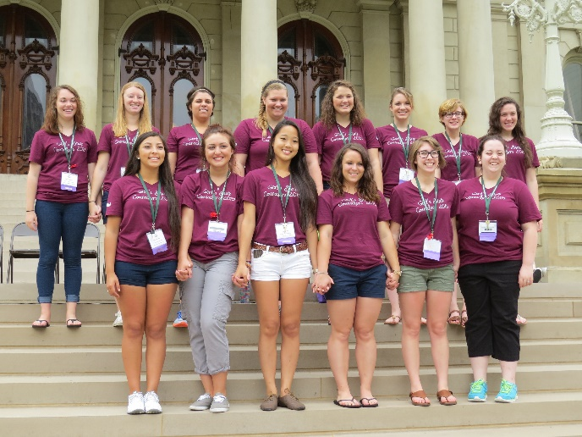
The staff…
Girls State is governed by the Girls State Committee and Department Executive Board. Working behind the scenes and handling the administrative duties are 20 American Legion Auxiliary members that volunteer their time.
We have a Government staff of 18 qualified professionals that teach and guide you through the political and judicial process. Most hold positions in Michigan government, the legal field or education.
Your first point of contact should always be your City Counselor! This includes illness, any emergency, bullying, or a problem with your roommate. She is there to help you!
Our City Counselors are former Girls State Citizens who are available to assist you 24/7. Twelve City Counselors report to our two Co-General Counselors who serve as liaisons to the American Legion Auxiliary staff.

Slide 7

Medical Services
Have no fear! ALA Girls State has nurses on staff 24/7!
When you arrive at ALA Girls State the nurses will be waiting for you in the Registration line. Make sure you have your completed Medical form with you, it is a mandatory form!
For your own protection, you will be required to turn in your prescription drugs to the nurse at that time (with the exception of epipens, inhalers and birth control medications).
Please bring them in their original prescription bottles so they can be easily identified in case of an emergency.
They will be placed in a gallon zip-lock, and properly labeled with your name, city name, and room number.
It will be up to you to report to the nurse when it’s time to take your medication. The nurse will track you down if you fail to report for your daily medication.
There is a Medical Clinic on campus and a Hospital close by. Parents/Guardians will be contacted immediately if an emergency situation arises for consent if treatment is needed.

Slide 8
Important Information!
Note the Deadlines
MEDICAL FORM INFORMATION
A sports physical dated after May 1, 2017 is acceptable, and must be stapled to our form.
Our medical form must be completed and signed by a parent or legal guardian.
If you don’t have a sports physical, our medical form must be completed and signed by a physician.
If you have asthma, allergies or any other medical condition that requires special attention please make sure it’s on the form!
Bring the completed medical form with you on Registration Day. You cannot attend ALA Girls State if we do not receive this form, as the clinic or hospital will not treat you.
The CHECKLIST you receive from your sponsor is your shortcut guide to everything you need to know before coming to ALA Girls State. Please review it immediately and read the information with your Parents. It will direct you to our website: www.michalaux.org, click on Girls State, where you will find all the required forms you’ll need to print, complete, and bring all required forms with you on Registration Day!
Do you have a special diet you have to follow? MSU caters to those special needs such as peanut and other food allergies, vegetarian, vegan, lactose intolerant and gluten free diets.
Please make sure you report any allergies to food, drugs, or objects when you register online with MSU, and indicate if it is an airborne allergy.

Slide 9

Are you the daughter, granddaughter or great-granddaughter of a war-time veteran and attending ALA Girls State in 2018? If your answer is YES, then apply for a Samsung Scholarship!
Samsung, a worldwide leader in electronics, endowed a scholarship fund of $5,000,000 to be administered by the American Legion to show appreciation for our U.S. Veterans who aided in the efforts during the Korean War. This scholarship is only awarded to participants of ALA Girls State and AL Boys State who complete the entire week of the 2018 ALA Girls State or TAL Boys State Programs.
You could win one of the following awards: $1,250 for Department Finalists; $5,000 for Ten National Runners-up; and $10,000 for Ten National Scholars!
Information on how to apply on-line is on your Checklist and at www.michalaux.org under Scholarship Opportunities, along with answers to frequently asked questions. The Application link is: https://www.legion.org/Samsung-scholarship-application. Make sure you follow the rules; if it is not completed properly, and submitted by MIDNIGHT, JUNE 16, 2018, your application will not be considered. NO EXCEPTIONS!
You must attach a Veterans Verification Document, such as DD-214 (proof of honorable discharge) for your relative. If you do not have this document available you can apply for a copy at www.archives.gov/veterans/, please note in takes approximately six weeks to receive your documents so start the process now! Eligible dates are:
World War I - Apr. 6, 1917 - Nov. 11, 1918 Lebanon/Grenada - Aug. 24, 1982 - Jul. 31, 1984
World War II - Dec. 7, 1941 - Dec. 31, 1946 Panama - Dec. 20, 1989 - Jan. 31, 1990
Korean War - June 25, 1950 - Jan. 31, 1955 Vietnam War - Feb. 28, 1961 - May 7, 1975
Persian Gulf War - Aug. 2, 1990 - Until cessation of hostilities Includes Operations Enduring Freedom, Iraqi Freedom, and War on Terrorism

Slide 10
What do I need to bring?
Your DORM ROOM includes:
One to Three roommates
A bed, dresser, closet, mattress pad, a very flat pillow & a scratchy blanket.
A linen pack will be on your bed that includes sheets, pillow case, and a towel. You can obtain washcloths and trade dirty linens in for clean ones at the MSU desk on the first floor.
What your DORM ROOM might need:
Your own pillow and light blanket;
An alarm clock;
A clamp light for reading;
Pictures of your family & boyfriend;
A flash light in case of an emergency;
A FAN should really be mandatory!
You can bring snacks from home.
Your favorite stuffed animal, anything really that makes you feel at home, just remember, it’s more to carry to your room and pack up when you leave!
You will not be sharing a room with a friend that lives close to you, so please don’t plan on sharing anything you bring like a fan or hair dryer.
Don’t forget your personal care items!
Toiletries: bar soap, shampoo, conditioner, toothbrush, toothpaste and deodorant.
Your own washcloth or scrubbie;
Hair dryer and curling iron.
Sanitary items – plan ahead!
Be courteous, many girls are allergic to perfumes, check with your roommate to make sure she isn’t before using it.

Slide 11

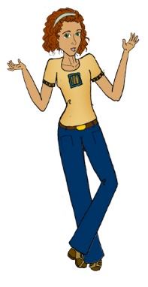

What Clothes Should I Wear?
For daytime wear we suggest MODEST casual clothes such as shorts, jeans, tops and casual foot wear.
We know it will be hot that week, but ask you to please avoid skimpy tops and shorts that are way too short.
Many girls like to wear a sun dress, or maybe a skirt or nice slacks with a blouse for dinner each night, but this is not required.
For our day at the Capitol we encourage you to wear the Girls State T-shirt with either navy blue or black shorts or slacks.
Dress Occasions – we have 3 events were we ask you to dress a little nicer than you do during the day.
  Our Opening Ceremony on Sunday
  City Pictures and Voting on Wednesday; and
  The Closing Awards Ceremony on Saturday
Formal attire isn’t necessary, but a dress or sun dress, two-piece suit, or skirt/slacks with a blouse is just fine.
Be prepared for that crazy Michigan weather and bring rainwear, umbrella, jacket, sweater and a sweatshirt.
We do not want anyone to feel they have to run out and buy a new wardrobe for Girls State!
Comfortable Shoes!
You will be doing LOTS of walking,! Flip flops are popular, but make sure you bring a back-up, or lots of Band-Aids!

Slide 12
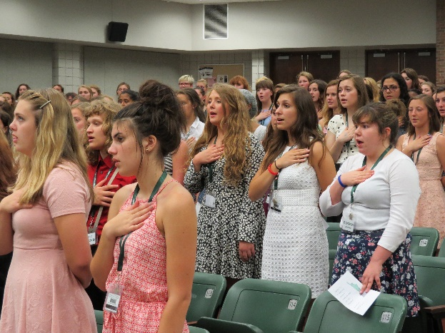
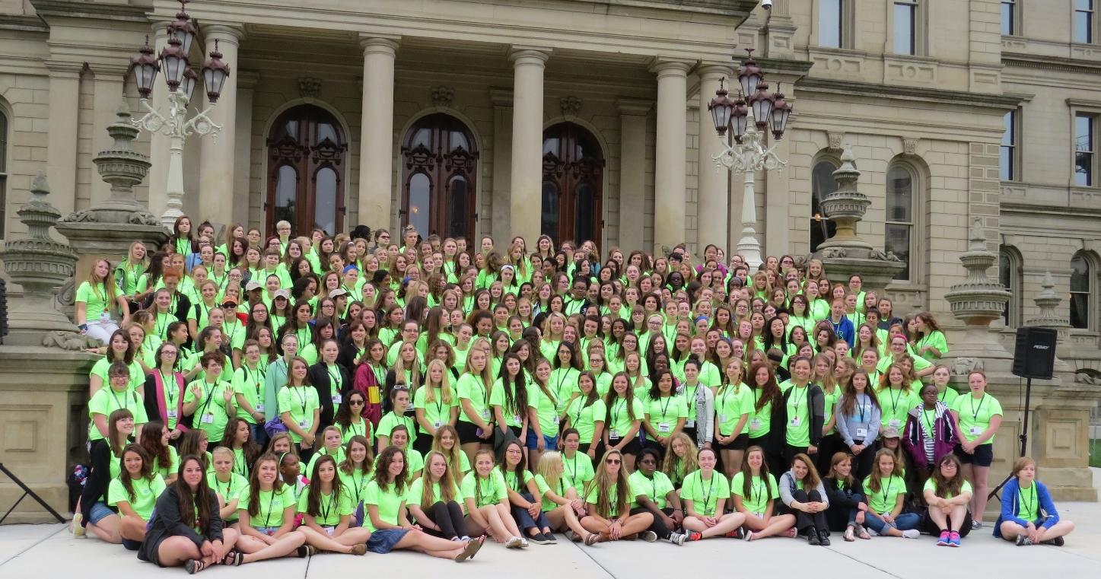
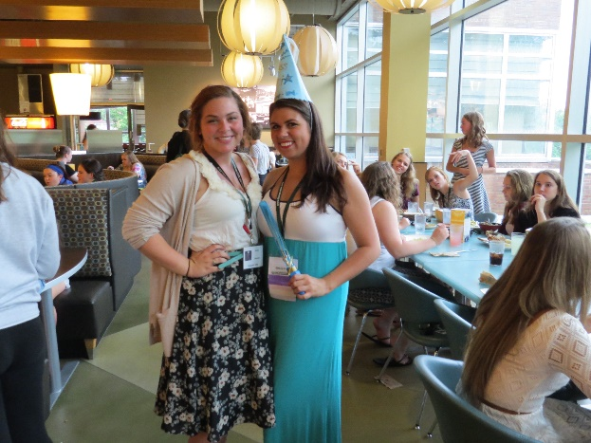
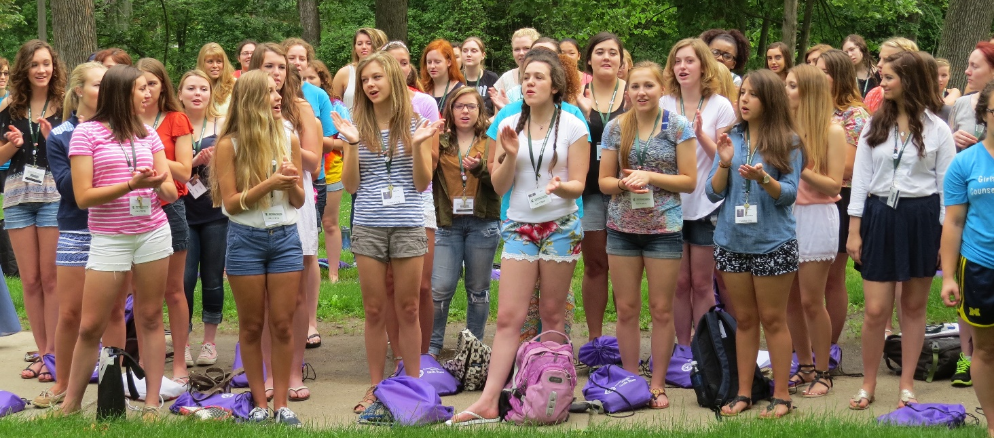
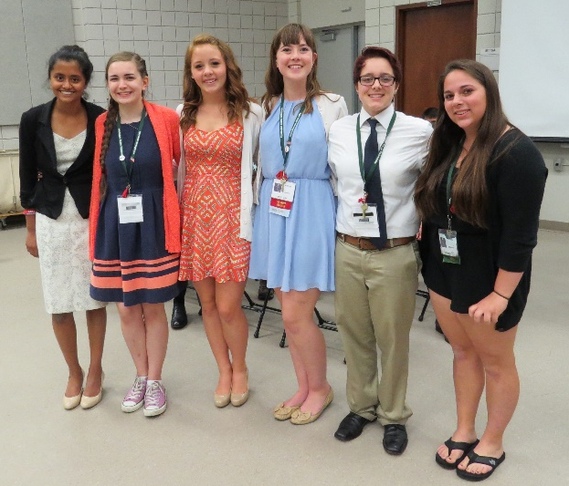

Slide 13



What Else do I need?
Will I need to bring some money?
We suggest bringing $25 to $40 with you depending on your personal needs.
We have a Girls State bank you can deposit your money in to keep it safe.
We are not responsible for money that has not been banked, so play it safe, make a deposit!
The bank is open during lunch and dinner so you can withdraw any money you need for the day.
Girls State has a store that is open during lunch and dinner. We sell t-shirts, sun glasses, yoga pants, bandanas and other items. Try and get your parents to purchase those for you on registration day so you can save your money for other things during the week!
You are permitted to bring laptops, cameras, and cell phones at your own risk.
For your CLASSES you’ll need:
A notebook with paper
Pens and Pencils
A calculator
You can bring your favorite snacks!
Do you have a special TALENT?
We have a talent show on Friday evening;
Each City selects a talent to represent;
If you sing, bring your voice;
If you play an instrument, bring it;
We can usually provide a piano ;
If you dance, bring your costume.

Slide 14
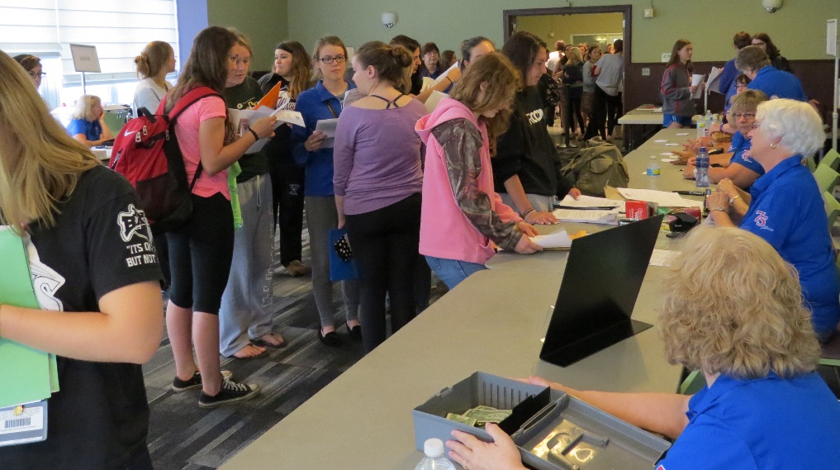
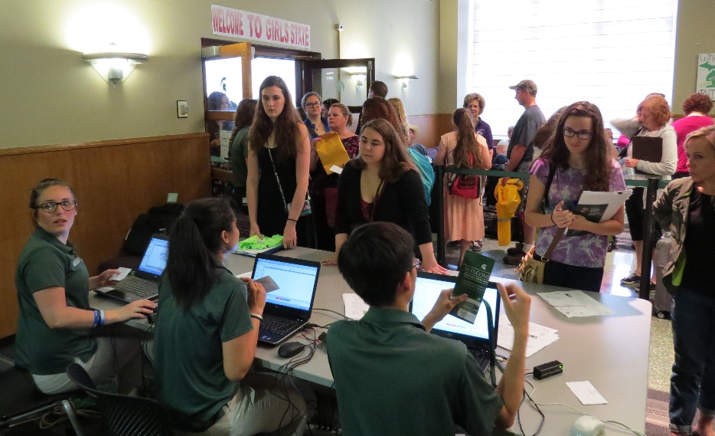
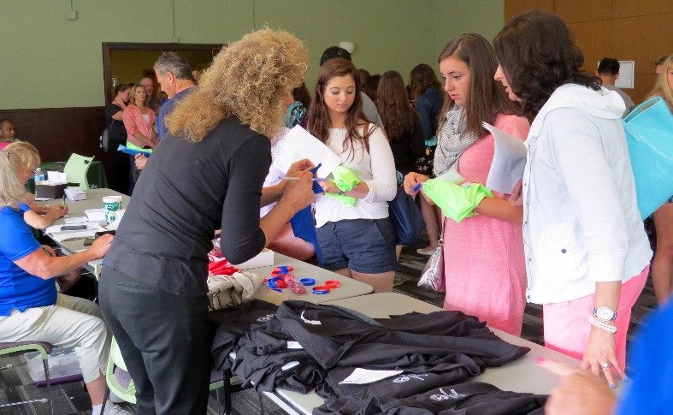
It’s Registration Day!
Sunday, June 17, 2018
9:00 a.m. to 11:00 a.m.

Slide 15
What happens on Registration Day?
Registration is on Sunday, June 17, 2018 from 9:00 a.m. to 11:00 a.m. Please make every attempt to be there during these hours. If an emergency prevents you from arriving before 11:00 a.m. please call the Girls State cell phone 517-575-9348 immediately and let us know what time to expect you. If you do not call we assume you are a no-show and your spot will be given to an Alternate.
Your first stop will be the Girls State Registration Desk where you will receive a 3 x 5 card with your name, dorm room number, whether you will be on the East or West side of Shaw Hall, what city you will be living in, and whether you are a Federalist or a Nationalist.
The nurses will be there to collect your prescription drugs and take your medical form. Please make sure you bring your medications in their original prescription bottle/container! They will place your medications in a
Ziploc and label it with your name, city name and room number.
Turn in your Required Forms! Medical Form, Consent Form, Government Questionnaire, etc.
You will have the opportunity to purchase your Girls State T-Shirt for $10 and other Girls State Merchandise that is available.
The Girls State Bank will be open for deposits. We recommend that you “Bank” your money to avoid losing it. You will need money for the vending machines, a possible trip to the MSU book store or the MSU ice cream store, and $7 or $8 for City Taxes that your City Counselor will collect.
Your last stop before heading to your dorm room will be at the MSU Desk to pick up your room key, and key card for entry into the cafeteria. Have your 3x5 card handy to show them, this will speed up the process.

Slide 16

Welcome to your City!
Your City Counselor will be waiting for your arrival with backpack full of materials you’ll need for your week at ALA Girls State. She will show you where your room is, and the door will have a special name tag made especially for you by your counselor.
You’ll meet your roommate and other citizens assigned to your city – wear a smile and you can’t go wrong!
Arrive early and be there to greet other citizens as they arrive, it could be good PR if you plan on running for an office later in the week!
This is your opportunity to let your counselor know if you have a special diet you need to follow, any special needs that we need to accommodate, carry an epipen and/or have any other medical conditions she needs to be award of. You can do this privately if you are more comfortable, these things are important and we don’t want anyone to feel uncomfortable.
You will have an opportunity early in the week to review your name, address and email address. This is used for your name tag, awards, and for a roster that is printed for everyone at the end of the week. MAKE SURE YOUR INFORMATION IS CORRECT! Enjoy your stay at Girls State!

Slide 17


Your Backpack will contain…
The Girls State Government Manual
  This is also available on our website at www.michalaux.org if you want to review it before you arrive. Your only opportunity to study for the bar exam will be Sunday evening.
  The bar exam is administered first thing Monday morning.
  Passing the exam allows you to become a member of the Bar Association and enables you to run for a judicial position.
The Girls State Loyalty Pledge
  Read this carefully! It states you will take part in all ceremonies, stay the entire session, participate in the program, report back to your sponsoring organization, and you MUST show respect for the flag of the United States during our daily flag ceremonies.
  If your beliefs prevent you from saluting the flag, or reciting the Pledge of Allegiance, we ask that you stand silently with your hands by your side and respect those around you.
You will also receive the flag code, an evaluation form, and a counselor application to complete if you’re interested in returning to Girls State as a counselor.

Slide 18

Important Stuff…
IF YOU DRIVE YOURSELF TO GIRLS STATE!
Park in the Shaw Hall Parking Ramp when you arrive. Once you check in with your City Counselor you will let her know you drove yourself to Girls State!
We will have a shuttle system in place where you will be escorted to a free parking lot.
When you return to Shaw Hall you will take your keys to the American Legion Auxiliary office where you will fill out a tag to attach to your key ring with your name, car model and license plate number.
DO NOT PARK ON YOUR OWN! We are not responsible for tickets issued because you parked in a restricted area You will receive daily tickets and you could be towed!
DO NOT LEAVE VALUABLES IN YOUR VEHICLE!
Be safe driving!
Obey traffic laws!
Don’t text and drive!
Use voice commands, and
Call home when you arrive at MSU safely!
Follow our Parking Instructions…
Don’t let this happen to you!

Slide 19

M.S.U. RULES
DON’T YOU DROP THOSE KEYS!
You will be issued a key to your dorm room, a key for the shower room, a key card used to access the cafeteria, a card holder, your name tag, and an MSU lanyard to attach everything to.
If you lose your room key there is a $75 charge YOU will be responsible for.
If you lose your shower room key there is a $15 charge YOU will be responsible for.
If you lose your key card there is a $10 charge YOU will be responsible for.
If you lose your nametag, or other personal items… well you might have to do something special to get them back.
Just saying…be responsible…keep track of your belongings!
DIRECTIONS & CONSTRUCTION MAPS
Google MSU Wilson Road Extension or Check out http://maps.msu.edu for up to date construction details, and maps of the campus. Currently there is construction near Hagadorn Road, so you better option would be to access Shaw Lane from Harrison. Allow extra travel time!
MSU IS A NON-SMOKING CAMPUS

Slide 20

Safety First!
PARENTS: PLEASE BE ASSURED THAT THE SAFETY OF YOUR DAUGHTER IS OUR MAIN CONCERN!
MSU has 24 hour security inside Shaw Hall and on Campus;
MSU will keep us informed on safety and weather issues.
NO VISITORS!
We do not allow visitors at ALA Girls State;
You can send packages and mail, but please make sure they are mailed in time to arrive at Girls State before Saturday, June 24th; and
Parents will not be allowed in the Dorm area at any time.
IN CASE OF AN EMERGENCY…
We will call the emergency contact number you provided us if your daughter is in need of any treatment, or has to be taken to the hospital;
If there is an emergency at home, or a death in the family, PLEASE CONTACT THE EMERGENCY NUMBER WE PROVIDED YOU BEFORE CONTACTING YOUR DAUGHTER DIRECTLY.
  This number is monitored 24/7: 517-575-9348
  We will find her immediately and have her call you;
  It’s important that she is not alone when she hears bad news;
  Arrangements can be made for her departure if necessary.
  We don’t want her to be in her room alone, packing to leave before we know what the situation is.

Slide 21
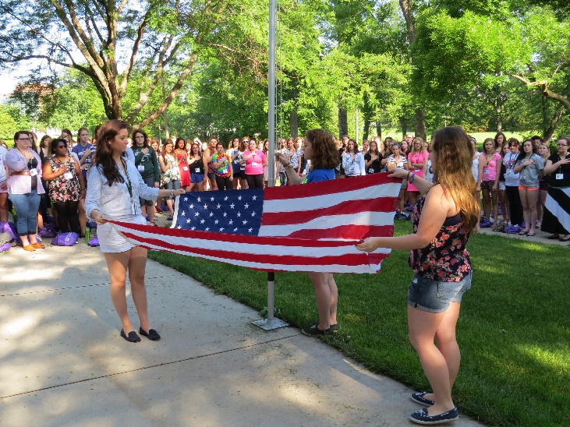
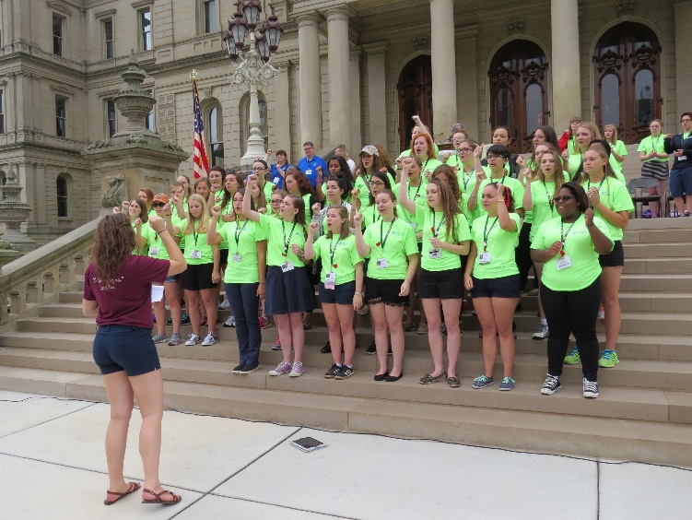
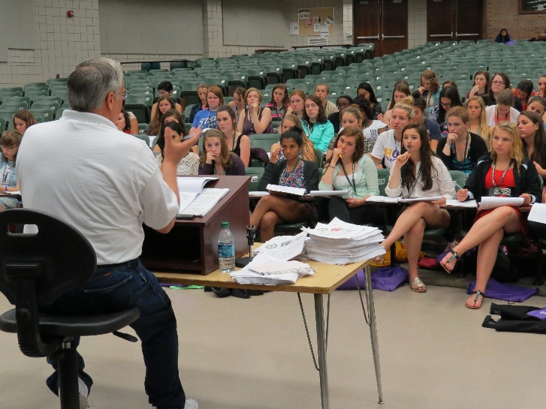
A look at our week…
Rise at 6:30 a.m. and lights out at 11:30 p.m.
Every morning starts with a flag raising ceremony, then city, county and state meetings.
Flag retreats are also held daily just before dinner. These are mandatory events!
Join the Girls State Choir for a chance to perform Thursday on the Capitol steps, and at our closing Ceremony. The Choir practices daily during the lunch hours.

Slide 22
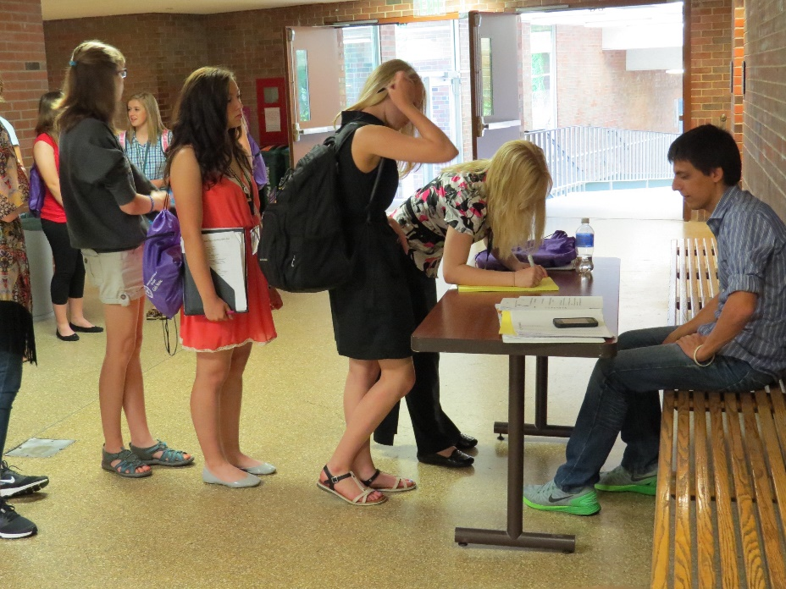
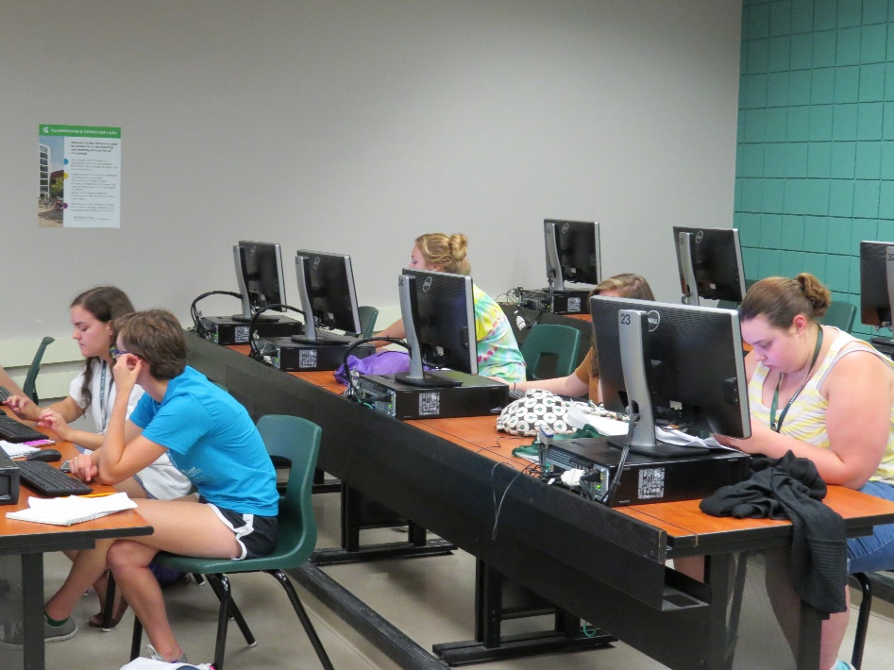
Planning to run for an office?
You must secure signatures on a petition;
Make campaign posters
  Only posters made while you are at Girls State are acceptable
  NO PREMADE POSTERS ARE ALLOWED!
If you pass the bar exam you are automatically a member of the Bar Association and eligible to run for a judicial position.
If you prefer not to run for an office
You can be a reporter for your city, writing articles, reporting news by blogging, tweeting, and on Facebook. In 2015 we updated our program from producing a hard copy newspaper to reporting news using the electronic methods available to us.
You can also enter contests for best short story, poem or pencil drawing
The contest entries MUST BE DONE DURING GIRLS STATE!

Slide 23
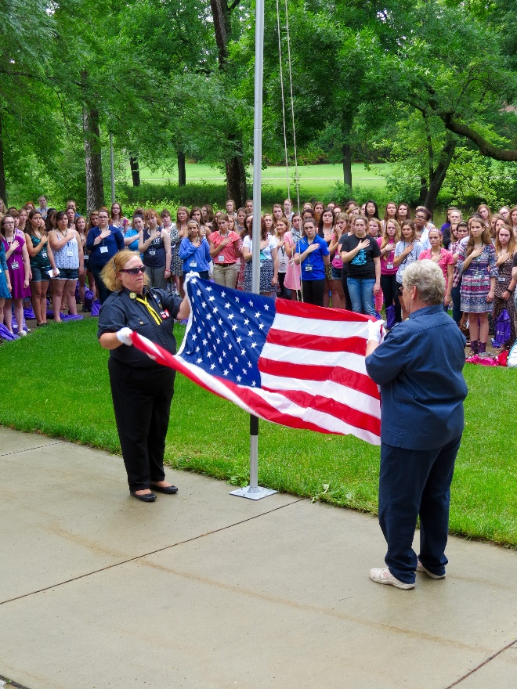
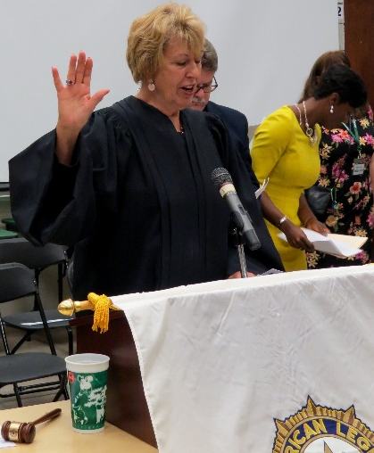
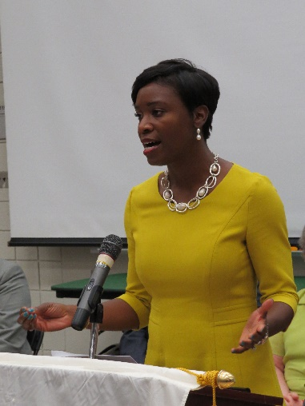
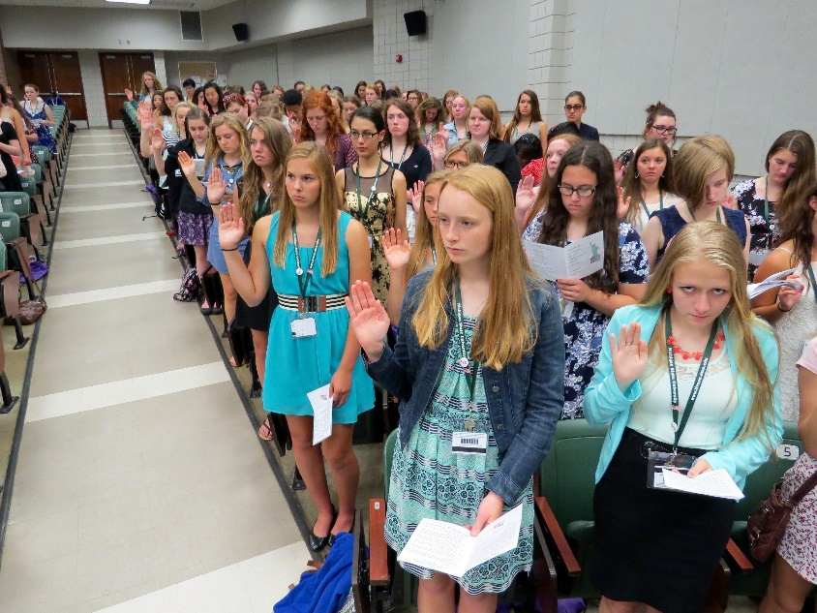
SUNDAY after registration, your first city meeting, lunch, and more meetings, the American Legion Auxiliary ladies will demonstrate the proper way to raise, lower and fold the American Flag. The rest of the week 3 citizens from each City will have the opportunity to perform this ceremony…so pay attention to the Ladies!
During our Opening Ceremony you will be sworn in as Citizens of the 2018 American Legion Auxiliary Girls State by a real judge. Following the swearing-in ceremony there will be a keynote speaker, usually a women in government, greetings from officers of the American Legion and American Legion Auxiliary, and the 2017 Girls State Governor.

Slide 24
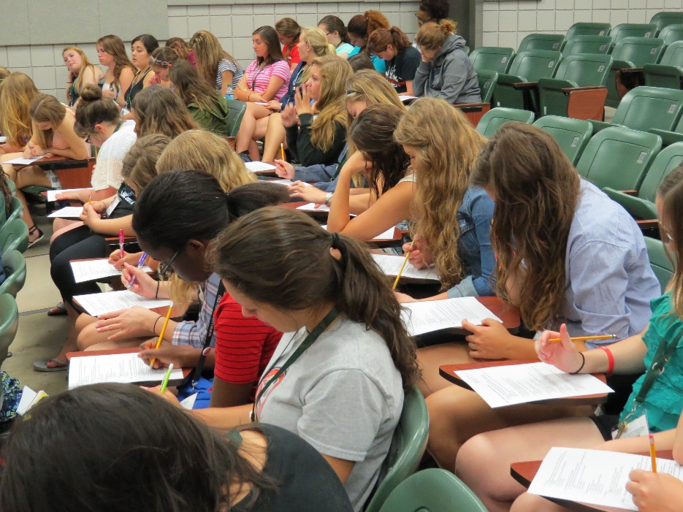
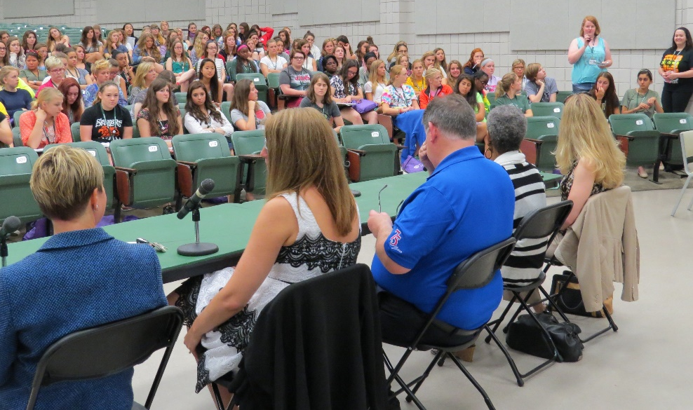
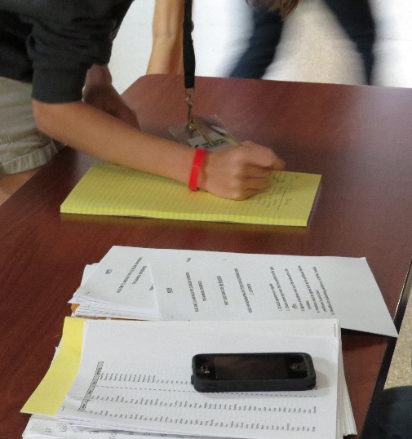
Monday morning the Bar Exam is administered in your County room. If you pass the Bar Exam you are automatically admitted to the Girls State Bar Association, and eligible to run for a judicial office, become an attorney for the prosecution or defense, and participate in a moot court and mock trial at the end of the week.
Each County has its own profile and a unique set of political problems. You will elect city and county officials who must work out solutions to those problems. The first two days at Girls State are the roughest, stick with it, you will not regret it!
Sign up sheets will be posted for Party interviews. Be active, have fun, and don’t be afraid to try something new!
Nominations are held for NAT and FED Candidates.
You will participate in A Women in Government Panel discussion. You will learn tips and hear stories from three successful women in government positions.

Slide 25
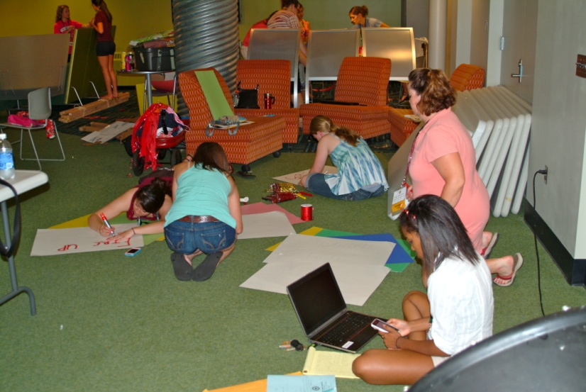
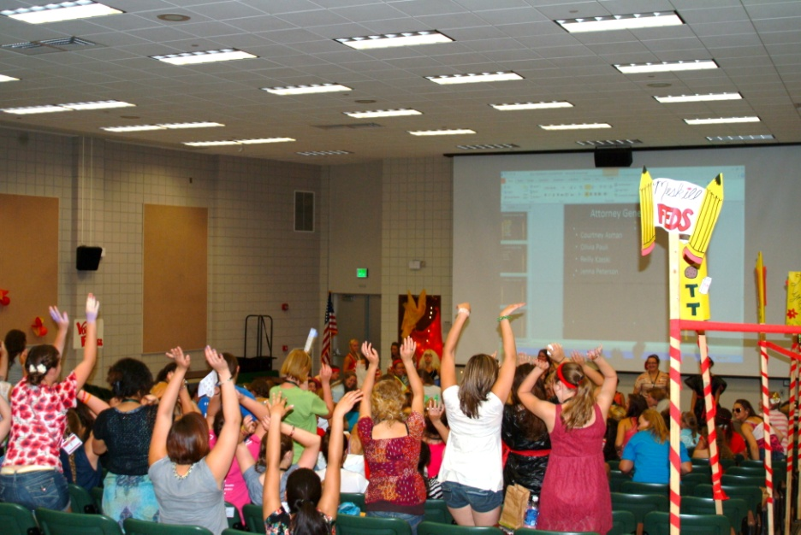
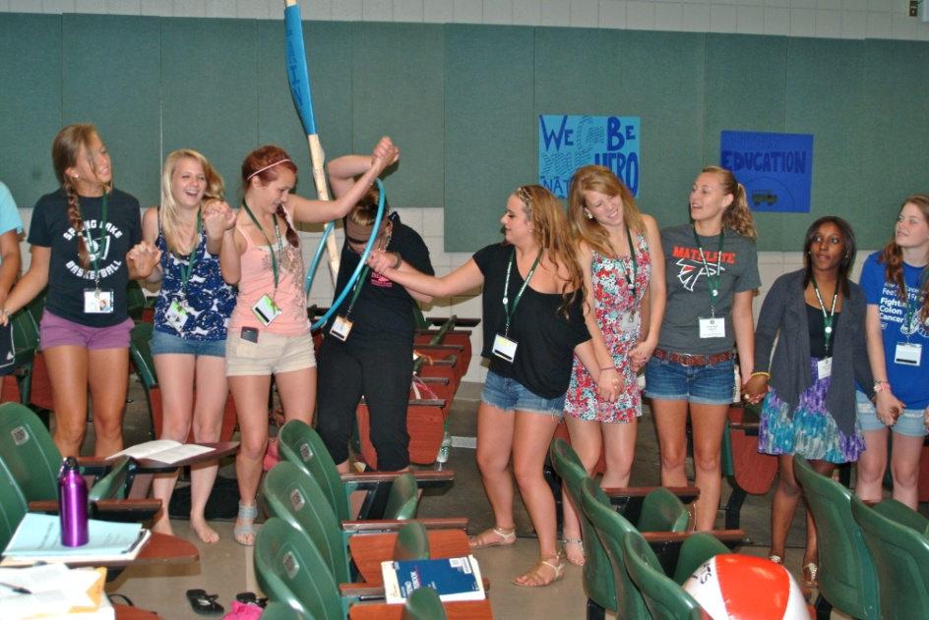
It’s Tuesday and you survived the two longest days of classroom activities! You’ve been taught everything you need to know to begin running your own City, County and State! State Conventions begin today and the Petitions for State Offices are available. The Local Courts are in session, Interest Groups, and the State Press Association are meeting daily.
The Nats and Feds are preparing for convention, creating campaign signs, decorations and practicing skits. Each Girls State City designs their own Convention sign that marks their place in the Convention Hall.

Slide 26
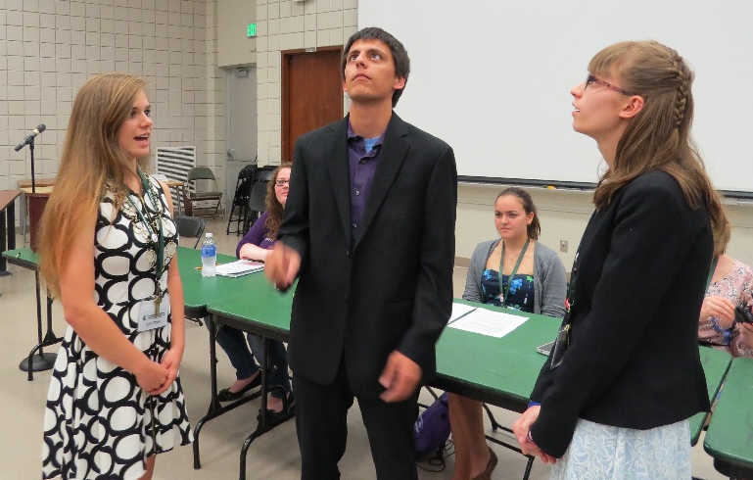
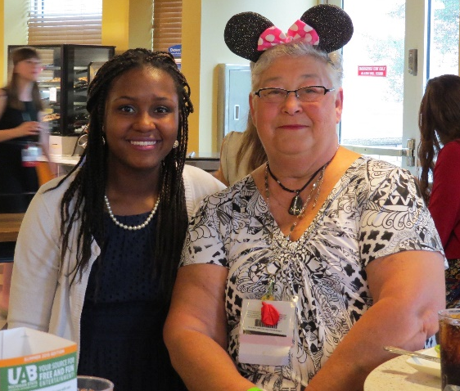
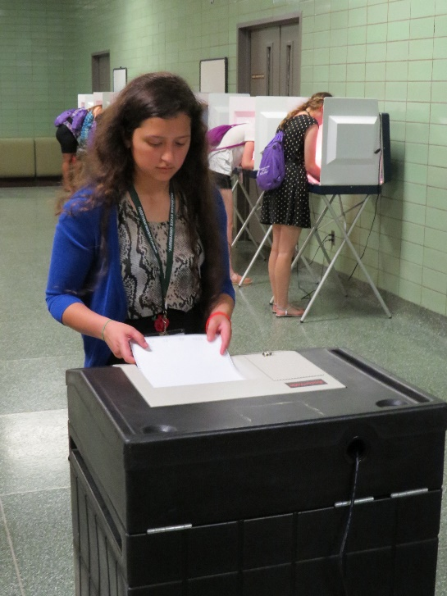
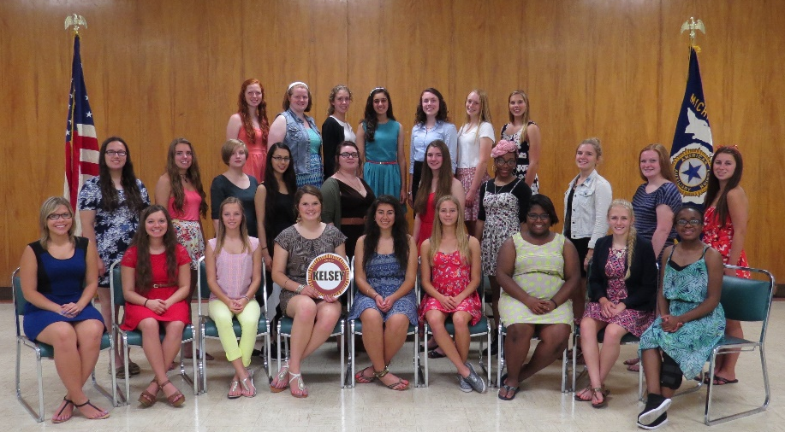
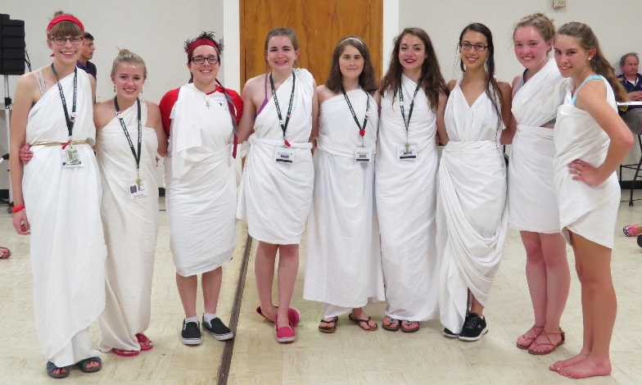
Wednesday is packed full of fun activities. The two Gubernatorial candidates hold their debate before lunch. Who will you vote for?
One of the Auxiliary volunteers may join you for dinner, followed by a tour of your City hall that’s been decorated with a special theme.
After dinner it’s time to pose for your City Picture before VOTING for your favorite candidates, using real voting machines and ballot box.
The Election Results are in, and it’s time for the TOGA PARTY. It’s an evening of dancing in the halls, putting on a toga, and anxiously awaiting to see who was voted to be the 2018 Girls State Governor, Lt. Governor, Secretary of State, Attorney General, and Five Supreme Court Justices!

Slide 27
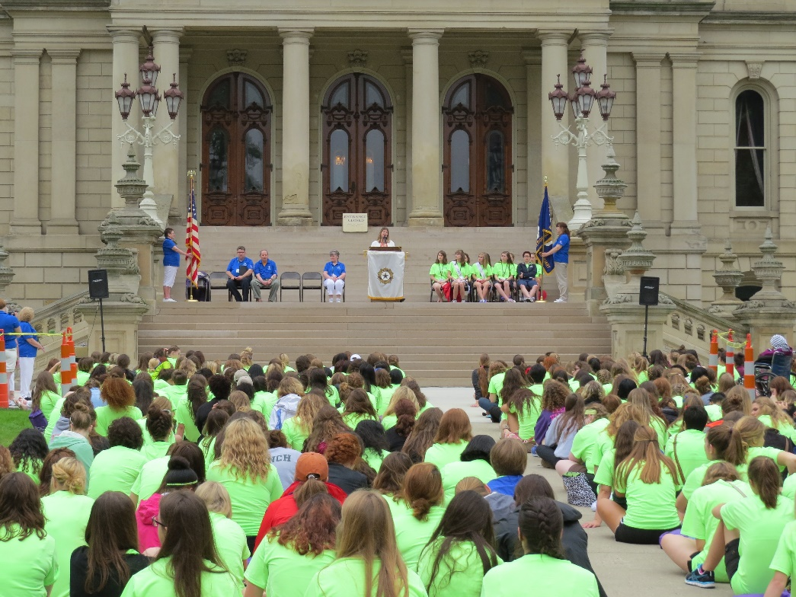
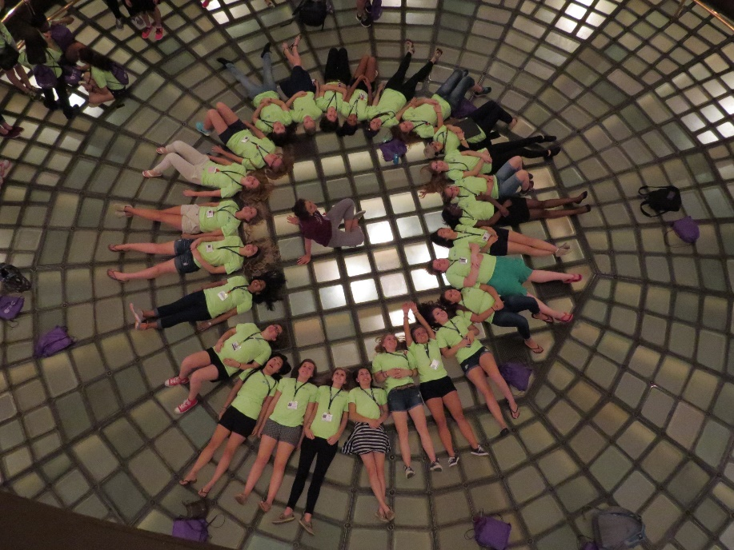
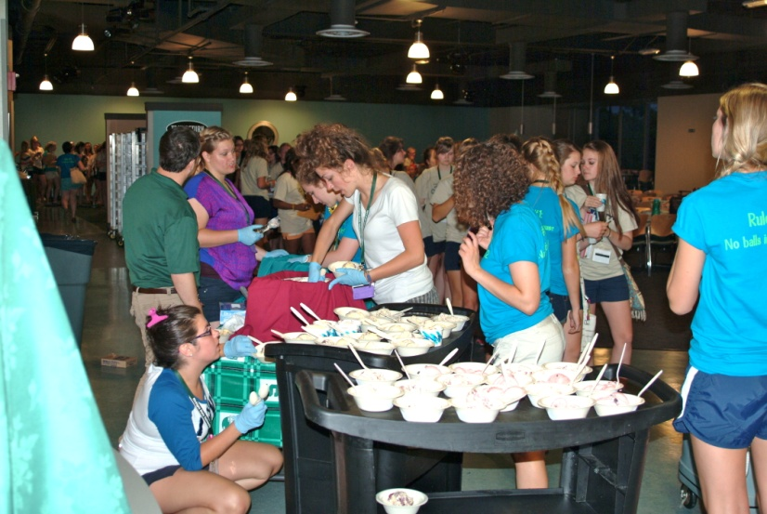
Thursday is Capitol Day! It’s the day the ALA Girls State Elected Officials are Inaugurated on the East steps of our State Capitol. For some of you it may be the first time you’ve had the opportunity to tour the Capitol, an amazing piece of Michigan’s history.
We encourage the ALA Girls State Citizens and Staff to wear their ALA Girls State shirt with navy blue or black shorts or slacks. Don’t forget to bring some comfortable shoes! Even though we take a bus to and from the Capitol we do lots of walking on Thursday!
In the evening the Counselors plan some fun free time. There might be time for a trip to the MSU book store, a movie night, or an Ice Cream Party.

Slide 28
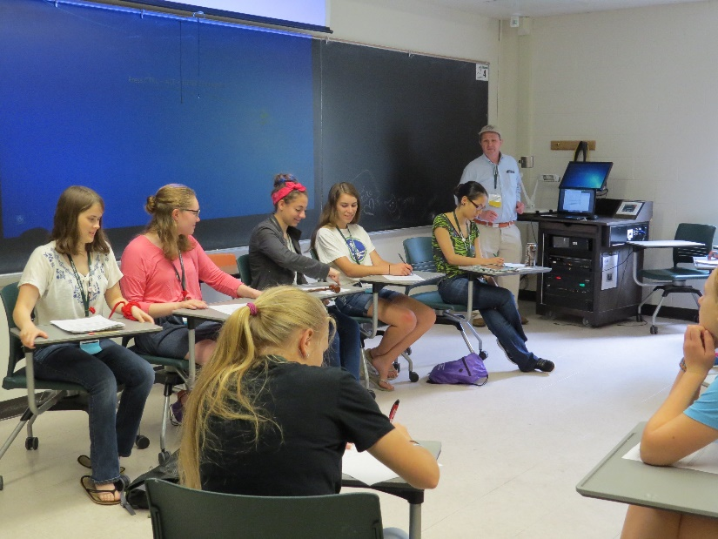
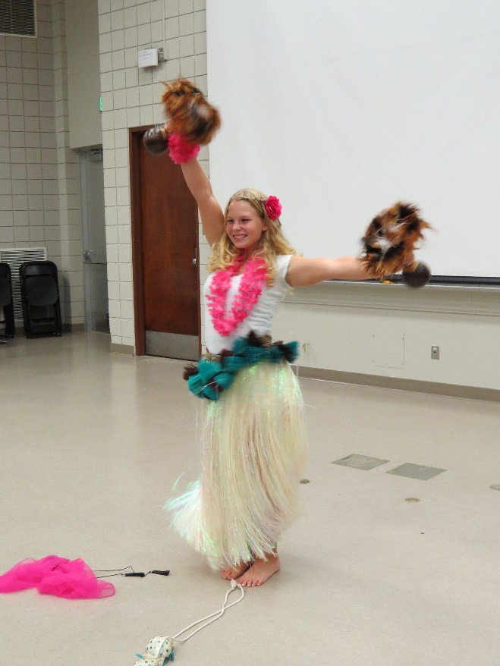
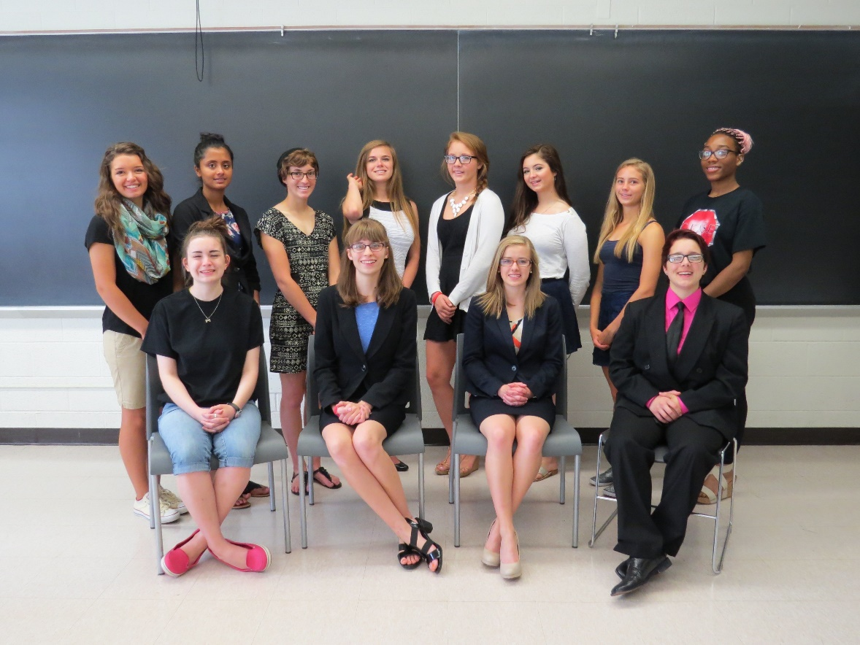
Friday, only two more days of ALA Girls State left! You are running YOUR STATE now! It’s back to work on budgets, research for bills being considered, and reporting the ALA Girls State news! Prosecutors will present their cases in local courts, defense counsel will represent their clients, and all those elected to judicial positions will be hearing those cases.
In the evening there will be a Talent Show. Each city will select one entry to represent them in the Talent Show.

Slide 29
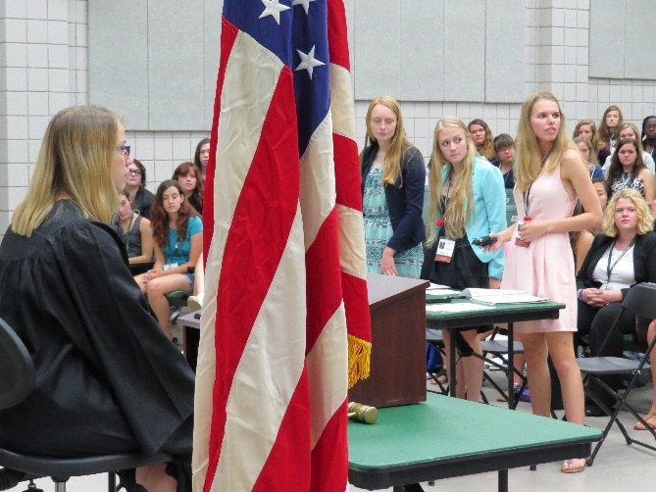
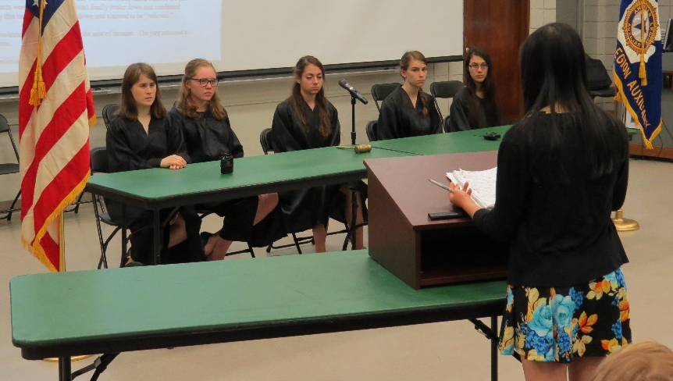
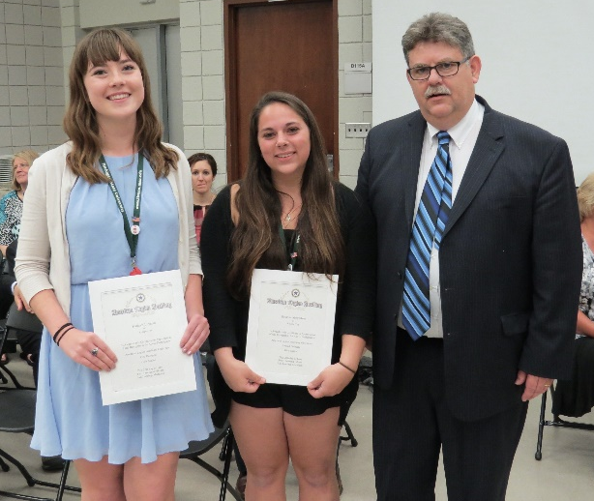
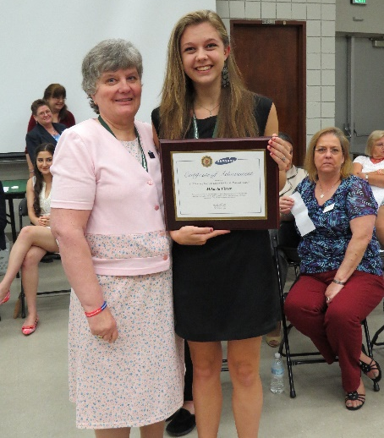
Last day, Saturday! You can’t leave ALA Girls State until you wrap up all those bills and balance that budget! The Judicial Branch of ALA Girls State has their day to show off their legal skills by participating in a Moot Court and a Mock Trial. The results of the Trial will be announced at our Closing Awards Ceremony before the other awards are presented.
Our Closing Awards Ceremony will be held on Saturday, June 23rd at 3:00 p.m. Parents are welcome to attend, however, seating is very limited. Your parents will not be permitted in Shaw Hall prior to the Closing Ceremony. Absolutely NO luggage goes out of Shaw Hall until we return from Wells. We anticipate the Closing Ceremony will end by 4:30 p.m. It is required that you attend the entire session, including the Closing Ceremony, in order to receive your Certificate & Girls State pin.
At our Closing Ceremony City Awards, County Awards, and Press Awards are presented. The Samsung Scholarship winner is also announced.
Then there’s Girls Nation… similar to ALA Girls State but based on federal government, where a President and Vice President are elected. Two Delegates will be selected to attend ALA Girls Nation as Senators from Michigan, and two Alternates are also chosen. This program is held in Washington D.C. in July. Candidates are selected by the Government Staff and interviewed on Friday evening.

Slide 30
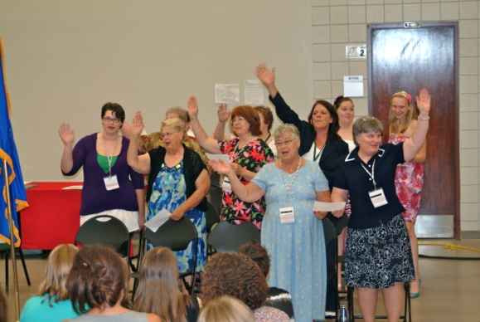
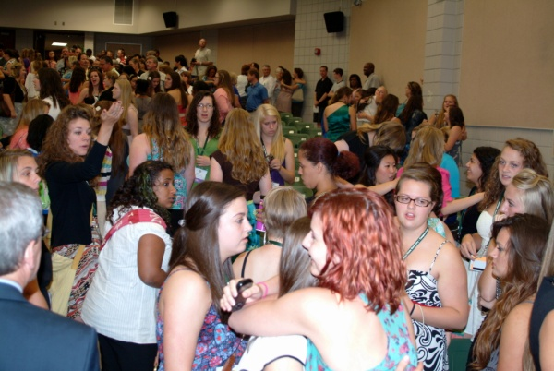
Get LOTS of rest before you come! The program is very strenuous, with very early mornings and late nights.
Attending ALA Girls State is a HUGE commitment!
We cannot stress enough that ALA Girls State is a progressive government simulation and a learning experience you can’t obtain from any other program.
If you have no interest in learning how the government process and judicial system works, then ALA Girls State may not be for you.
You will only get out of ALA Girls State as much as you are willing to contribute to it.
Involvement is the KEY to a successful week!
Come with a positive attitude and a smile.
PLEASE REMEMBER someone paid $350 for you to attend this life changing experience. Please present them with a report on your experience, either verbal or written.
If you decide this is not the program for you, please give an Alternate the chance to attend by contacting your sponsor and Girls State Chairman, Beryl Robbins, at 313-318-6845; or by email at berylrobbins@comcast.net.
The week ends, the Ladies of the American Legion Auxiliary send you home with a special goodbye, and now you don’t want to leave all your new friends! We told you that would happen!

